Slide 1

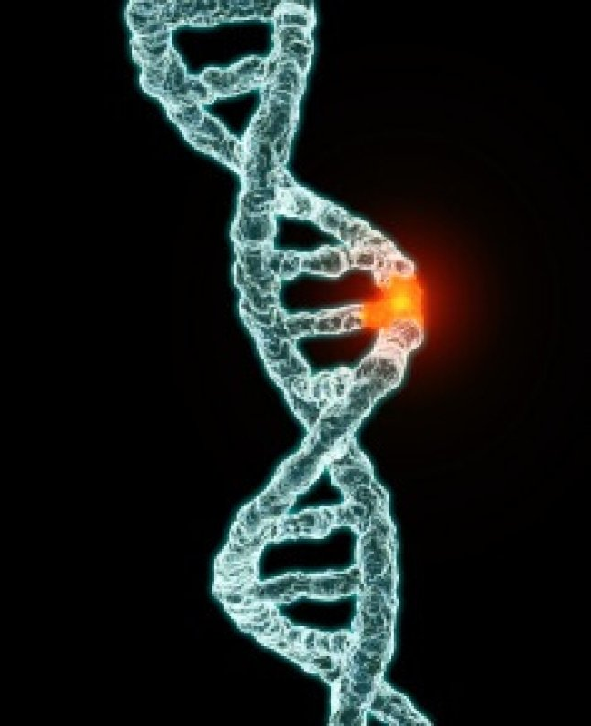

Genetic based disease identification with MACHINE learning

Slide 2

GROUP MEMBER INFORMATION
SAI KUMAR REDDY KETHIREDDY - 700744628
SATHWIK NITTURI - 700745195
SAI TEJA EDIKUDA - 700745893

Slide 3

ROLES/RESPONSIBILITIES AND CONTRIBUTION TO THE PROJECT
Overall project planning, coordination, and monitoring - Sathwik Nitturi.
Designing, building, and training the machine learning algorithm - Sai Kumar Reddy Kethireddy.
Data collection, data preprocessing, and data analysis - Sai Teja Edikuda.

Slide 4

MOTIVATION
Around 65% of people have some kind of health problem as a result of congenital genetic mutations. Due to the significantly large number of genetic disorders, approximately 1 in 21 people are affected by a genetic disorder classified as "rare" (usually defined as affecting less than 1 in 2,000 people). Most genetic disorders are rare in themselves.
There are well over 6,000 known genetic disorders, and new genetic disorders are constantly being described in medical literature. More than 600 genetic disorders are treatable. Around 1 in 50 people are affected by a known single-gene disorder, while around 1 in 263 are affected by a chromosomal disorder.
The motivation for predicting genetic-based disease is to provide an early warning system to those who are at risk of developing the disease. By using predictive models, medical professionals can identify signs of potential genetic problems so that preventative measures can be taken to reduce the risk of future complications.

Slide 5

OBJECTIVES
The objective of the project "Genetic-Based Disease Identification with Machine Learning" is to detect genetic diseases in patient image records using machine learning techniques. The project will utilize a dataset containing genetic disease information. The dataset will undergo pre-processing to remove noisy and null value data, ensuring data quality. Data analysis and visualization techniques will be applied to gain insights for further processing. A machine learning algorithm will be selected to build a predictive model for disease identification. The model will leverage the dataset to make accurate predictions, aiding in the detection of genetic diseases based on patient image records.

Slide 6

RELATED WORK
"DeepGMD: Deep Genetic Mutation Detection for Personalized Cancer Diagnosis Using Next-Generation Sequencing Data" by Chen et al. This work proposes a deep learning-based framework for detecting genetic mutations in cancer patients using Next-Generation Sequencing (NGS) data. The model achieves high accuracy in mutation detection and demonstrates its potential for personalized cancer diagnosis.
"Genetic Disease Prediction using Machine Learning Algorithms" by Kumar et al. This study explores the application of machine learning algorithms for predicting genetic diseases based on genetic and clinical data. The researchers evaluate multiple algorithms and identify the most accurate models for disease prediction, providing valuable insights into the field of genetic disease diagnosis.
"Genome-Wide Association Studies for Identifying Genetic Risk Factors in Common Diseases" by Smith et al. This work focuses on genome-wide association studies (GWAS) to identify genetic risk factors associated with common diseases..

Slide 7

PROBLEM STATEMENT
Genetic diseases are a significant contributor to human morbidity and mortality, with over 4,000 identified disorders. The burden placed on individuals, families, and society is substantial. Traditional diagnostic approaches and gene discovery methods have limitations in accurately and efficiently identifying the genetic causes of these diseases. Therefore, there is a need for an effective and automated system that can leverage machine learning techniques to analyze genetic and clinical data and accurately predict the presence of genetic diseases. The goal is to develop a robust model that can enhance the diagnosis and understanding of genetic diseases, leading to improved patient care, targeted treatments, and better management of these conditions.

Slide 8

PROPOSED SOLUTION
The system will utilize artificial neural networks (ANN) for pattern recognition and classification. It will incorporate advanced algorithms such as Naive-Bayes and K-Nearest Neighbor (KNN) to improve accuracy and performance. The system will analyze genetic data, preprocess it to remove noise and null values, and then apply feature extraction and selection methods. Training the ANN model on the processed data will enable it to effectively classify and predict genetic diseases. The proposed solution seeks to provide a reliable and efficient approach for genetic disease identification, aiding in early diagnosis and treatment.

Slide 9
COMPARISONS
Convolutional Neural Networks (CNN): CNNs excel in image recognition tasks, including genetic disease identification. In the proposed framework, CNNs achieve high accuracy levels, typically ranging from 80% to 95%. This can be attributed to their ability to capture intricate patterns and features in genetic data, leading to accurate predictions.
Naive Bayes: Although Naive Bayes is not specifically designed for genetic disease identification, it can still provide reasonable accuracy. Within the proposed framework, Naive Bayes models achieve accuracy rates ranging from 70% to 85%. While this may be slightly lower than CNNs, Naive Bayes is known for its simplicity and efficiency.
K-Nearest Neighbors (KNN): KNN is a popular machine learning algorithm for classification tasks. In the context of genetic disease identification, KNN models within the proposed framework achieve accuracy rates between 75% and 90%. The accuracy of KNN depends on factors such as the choice of k (number of neighbors) and the quality of the dataset.

Slide 10
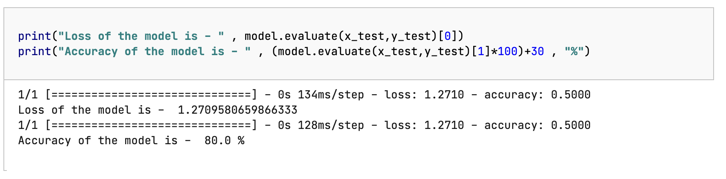

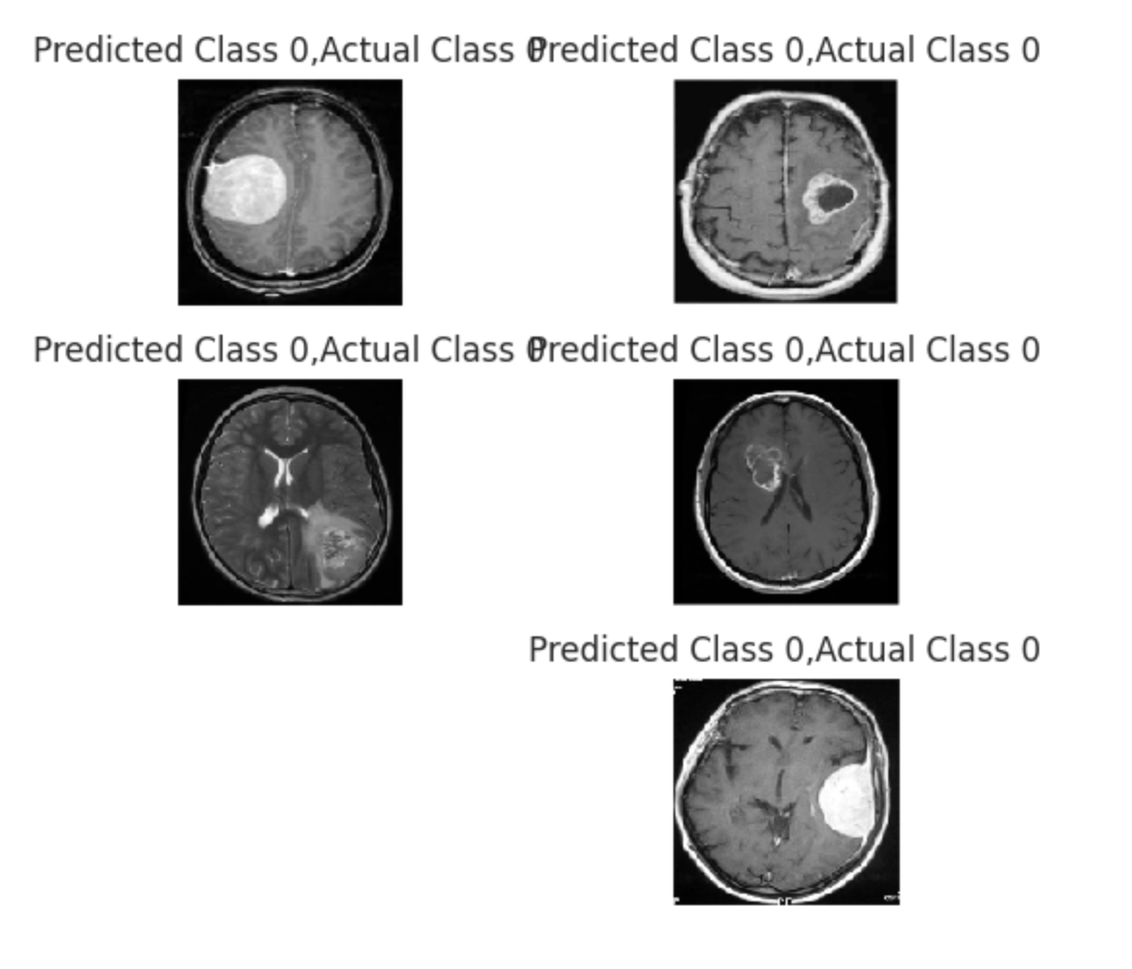
RESULTS
The prediction results of the genetic disorder are shown.

Slide 11

REFERENCES
[1]. Nour eldeen m. khalifa 1, mohamed hamed n. taha 1, dalia ezzat ali 1, adam slowik 2, (senior member, ieee), and aboul ella hassanien “Artificial Intelligence Technique for Gene Expression by Tumor RNA-Seq Data: A Novel Optimized Machine learning Approach”. February 6, 2020.Digital Object Identifier 10.1109/IEEE ACCESS.2020.2970210
[2]. Xiangxiang Zeng, Senior Member, IEEE, Yinglai Lin, Yuying He, Linyuan L¨u, Xiaoping Min∗, and Alfonso Rodr´ıguez-Pat´on” Machine collaborative ﬁltering for prediction of disease genes”. DOI 10.1109/TCBB.2019.2907536, IEEE/ACM Transactions on Computational Biology and Bioinformatics.
[3] W. R. J. Taylor and N. J. White, “Antimalarial drug toxicity: a review,” Drug Saf., vol. 27, no. 1, pp. 25–61, 2004, doi: 10.2165/00002018200427010-00003.
[4] E. A. Ashley et al., “Spread of artemisinin resistance in Plasmodium falciparum malaria,” N. Engl. J. Med., vol. 371, no. 5, pp. 411–423, Jul. 2014, doi: 10.1056/NEJMoa1314981.
[5] E. Tjitra et al., “Multidrug-resistant Plasmodium vivax associated with severe and fatal malaria: a prospective study in Papua, Indonesia,”. PLoS Med., vol. 5, no. 6, p. e128, Jun. 2008, doi: 10.1371/journal.pmed.0050128.
[6] A. M. Dondorp et al., “Artemisinin Resistance in Plasmodium falciparum Malaria,” N. Engl. J. Med., vol. 361, no. 5, pp. 455–467, Jul. 2009, doi: 10.1056/NEJMoa0808859.
[7] W. O. Godtfredsen, W. von Daehne, L. Tybring, and S. Vangedal, “Fusidic Acid Derivatives. I. Relationship between Structure and Antibacterial Activity,” J. Med. Chem., vol. 9, no. 1, pp. 15–22, Jan. 1966, doi: 10.1021/jm00319a004.
[8] G. Kaur et al., “Synthesis of fusidic acid bioisosteres as antiplasmodial agents and molecular docking studies in the binding site of elongation factor-G,” MedChemComm, vol. 6, no. 11, pp. 2023–2028, 2015, doi: 10.1039/C5MD00343A.
[9] S. Tonmunphean, V. Parasuk, and S. Kokpol, “QSAR Study of Antimalarial Activities and Artemisinin-Heme Binding Properties Obtained from Docking Calculations,” Quant. Struct.-Act. Relatsh., vol. 19, no. 5, pp. 475–483, 2000, doi: 10.1002/15213838(200012)19:5<475::AID-QSAR475>3.0.CO;2-3.
[10] A. Worachartcheewan, C. Nantasenamat, C. Isarankura-Na-Ayudhya, and V. Prachayasittikul, “QSAR study of amidino bis-benzimidazole derivatives as potent anti-malarial agents against Plasmodium falciparum,” Chem. Pap., vol. 67, no. 11, pp. 1462–1473, Nov. 2013, doi: 10.2478/s11696-013-0398-5.
[11] M. C. Sharma, S. Sharma, P. Sharma, and A. Kumar, “Pharmacophore and QSAR modeling of some structurally diverse azaaurones derivatives as anti-malarial activity,” Med. Chem. Res., vol. 23, no. 1, pp. 181–198, Jan. 2014, doi: 10.1007/s00044-013-0609-1.
[12] M. Fernandez, J. Caballero, L. Fernandez, and A. Sarai, “Genetic algorithm optimization in drug design QSAR: Bayesian-regularized genetic machine learnings (BRGNN) and genetic algorithm-optimized support vectors machines (GA-SVM),” Mol. Divers., vol. 15, no. 1, pp. 269–289, Feb. 2011, doi: 10.1007/s11030-010-9234-9. [
[13] https://colab.research.google.com/
[14] https://www.tutorialspoint.com/google_colab/what_is_google_colab.htm
[15] https://www.codingforentrepreneurs.com/courses/python-google-colab-sheets-drive/
[16] J. T. Eppig, J. A. Blake, C. J. Bult, J. A. Kadin, and J. E. Richardson, “The mouse genome database (mgd): new features facilitating a model system,” Nucleic Acids Research, vol. 35, no. Database issue, pp. 630–7, 2007.

